Slide 1
Probability: Basic Ideas
A set of basic experimental
outcomes
aka the Sample Space
A subset of outcomes is an
event
The probability of an event (v. 1.0):
lec 13W.1

Slide 2
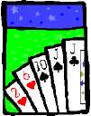
Counting in Probability
What is the probability of getting
exactly two jacks
in a poker hand?
lec 13W.2

Slide 3
Counting in Probability
Outcomes: 5-card hands
Event: hands w/2Jacks
Pr{2 Jacks} ::=
≈ 0.04
lec 13W.3

Slide 4
Basics of the 2-Jacks problem
An outcome is a poker hand
The sample space is the set of all poker hands
We are assuming that all hands are equally likely (no stacked deck, no cheating dealer)
The event of interest is the set of poker hands with two jacks

Slide 5
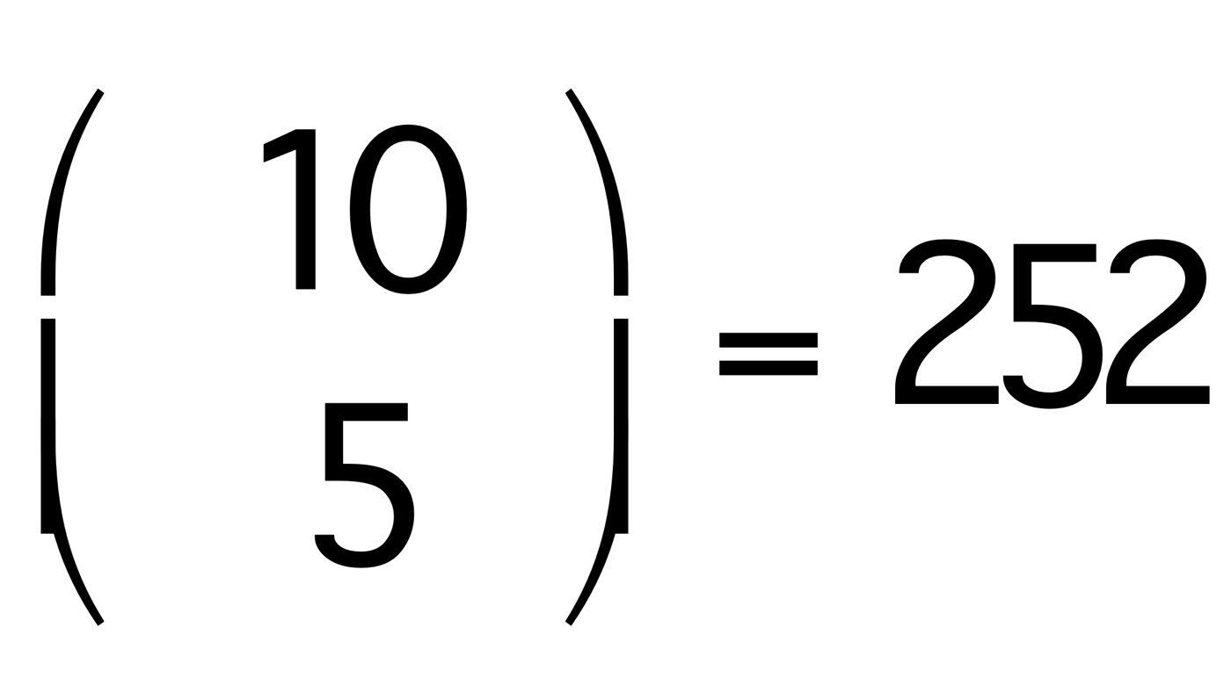
Flipping 10 coins & getting exactly 5 heads
Outcomes := {H,T}¹⁰
Event := {x₁…x₁₀: each x_{i} is H or T and exactly 5 are H}
|Outcomes| = 2¹⁰ = 1024
|Event| =
Pr(exactly 5 heads) = |Event|/|Outcomes|, which is a little less than one-fourth.

Slide 6
Assumptions!
Fair coin: H and T equally likely
No flip affects any other
So all 1024 sequences of flips are equally likely
In practice human beings don’t believe 2, and can be skeptical about 1
TTTTTTTTTx: What will x be?

Slide 7
Independent Events
Events A and B are independent iff Pr(A∩B) = Pr(A) ∙ Pr(B).
For example, let
A = third flip is H = {H,T}²H{H,T}⁷
B = fourth flip is T = {H,T}³T{H,T}⁶
Then |A|=512, |B|=512, Pr(A)=.5, Pr(B)=.5
A∩B = {H,T}²HT{H,T}⁶, |A∩B| = 256
Pr(A∩B) = 256/1024 = .25 = Pr(A) ∙ Pr(B)
So A and B are independent events

Slide 8
Non-Independent Events
Consider sequences of 4 flips
A = at least 1 H
B = at least one run of 3 T
Pr(A) = 15/16 since all but one sequence of 4 flips includes an H
Pr(B) = 3/16 since B = {TTTT, HTTT, TTTH}
A∩B = {HTTT, TTTH}
So Pr(A∩B) = 2/16 ≠ Pr(A) ∙ Pr(B) = 45/256
0.1875 ≠ 0.17578125

Slide 9
Some Basic Probability Facts
0 ≤ Pr(A) ≤ 1 for any event A
Since 0 ≤ |A|/|S| ≤ 1 whenever A⊆S.
Pr(∅) = 0.
Pr(S) = 1 if S is the sample space.
Pr(A∪B) = Pr(A)+Pr(B) if A∩B = ∅.
Pr(A) = Pr(S-A) = 1-Pr(A)
P(A∪B) = P(A)+P(B)-P(A∩B) for any events A, B (Inclusion/Exclusion principle).
_

Slide 10
Calculating Probabilities
Which is more likely when you draw a card from a deck?
A: that you will draw a card that is either a red card or a face card
B: that you will draw a card that is neither a face card nor a club?
The sample space is the same in either case, the 52 cards. So we can just compare the numerators

Slide 11
Calculating Probabilities
A: a red card or a face card
B: not a face card and not a club
= S – (face or club cards)
|A| = |red|+|face|-|red face| = 26+12-6=32
|B| = |S|-|face or club|
= |S|-|face|-|club|+|face club|
= 52-12-13+3 = 30
So more likely to draw a red or face card

